Slide 1

Hand Grasp Assessment Device with Variable Haptic Feedback– Work In Progress
Samid Ceballos¹, Panadda Marayong, Ph.D.¹, and I-Hung Khoo, Ph.D.²
^{[1]} Department of Mechanical and Aerospace Engineering, ^{[2]} Department of Electrical Engineering
Robotics and Interactive Systems Engineering (RISE) Laboratory
Notes:
Hello everyone, my name is Samid Ceballos. I am a mechanical engineering undergraduate researcher in Robotics and Interactive Systems Engineering Lab working alongside Dr. Marayong and Dr. Khoo. And today I’m going to be talking about our Hand Grasp Assessment Device.

Slide 2
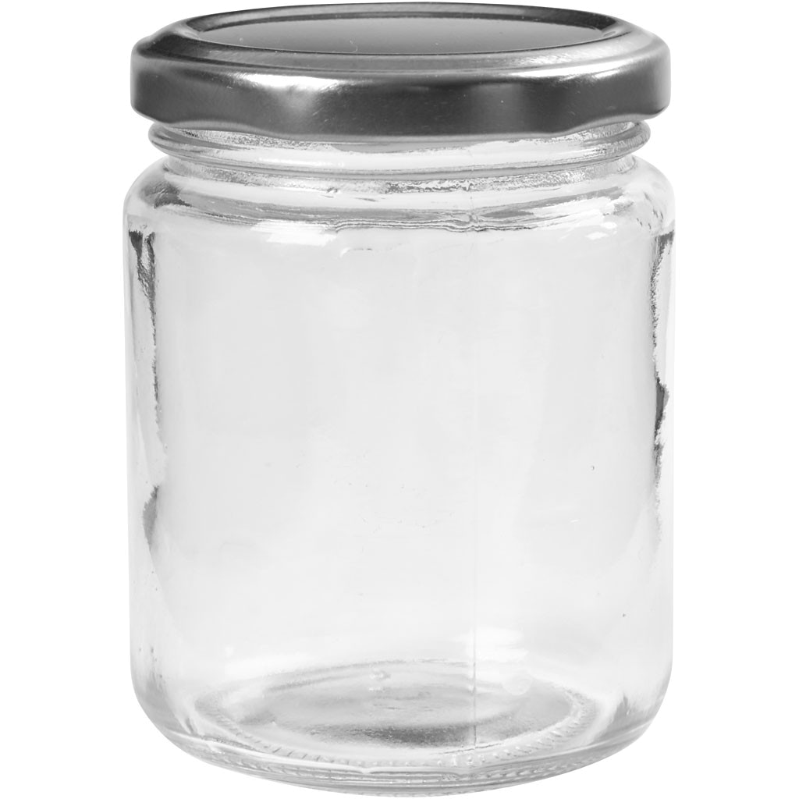
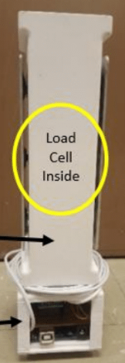

Introduction
Hand impairment is common in elderly over the age of 65 due to neuromuscular disorders and loss of skeletal muscle mass^{[1]}
Previous robot-assistive devices can provide intensive hand rehabilitation which promotes neuroplasticity; however, these systems are costly^{[4,5]}
Previously, a low-cost device was developed to assess grip force vs load force and arm movement coordination^{[3]}
Existing robot-assistive devices for turning tasks focus on turning torque^{[2,4]} and grasping independently^{[5,6]}
Figure 1. Jar^{[7]}.
Hand Cup Body
Electronics Chassis
Figure 2. Grip/Load Device
Notes:
So, we all know that we use our hands daily to interact and navigate our environment, such as opening this jar here. And I reference this specific looking jar because I am sure plenty of you have had trouble opening a jar at some point. Now, hand impaired individuals struggle with these activities of daily living. And hand impairment is common in older adults due to loss of skeletal muscle mass and neuromuscular disorders. As we shift into an era where there are more people over the age of 65, we might have more people with hand impairment. To address this, there has been various robot-assistive devices that provide rehabilitation which enable neuroplasticity. But these devices are expensive. Our, Lab previous developed a low-cost device to assess grip force vs load force and arm movement as you see in Figure 2. However, we again know that our hand is complex and grip vs load device does not define our whole hand function. Additionally, there is need to assess the coordination between grasping force and turning torque as existing research focuses on these variables independently. Therefore, we developed the hand grasp assessment device to fill in the literature gap and provide rehabilitative training to individuals with hand impairment. And in the future, we plan on integrating the grip/load device for a complete hand function assessment.

Slide 3
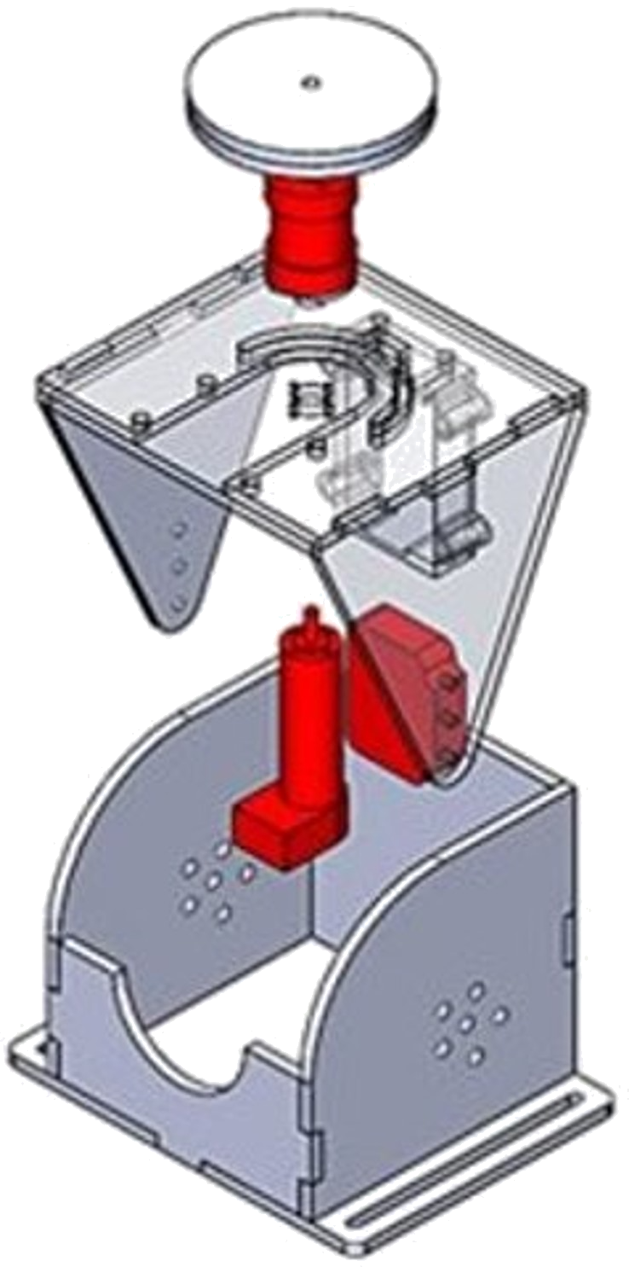
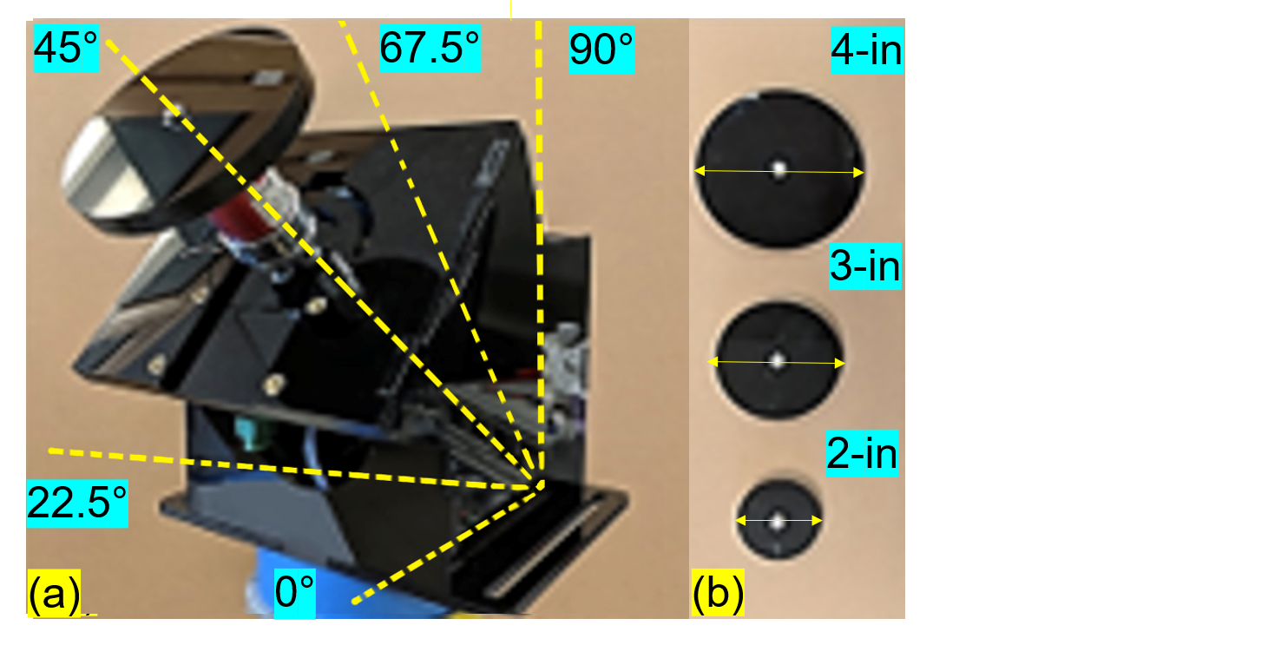
Acrylic structure with three available knob sizes and five angles from the horizontal.
DC motor with encoder for variable torque feedback and turn angle measurement
Torque sensor to acquire turning torque
Arduino Uno microcontroller with motor shield for sensor integration and actuation control
Hand Device System Overview – Hardware Design
Torque Sensor
Turnable
Knob
DC Motor with
Encoder
Amplifier
Figure 3. Exploded view
Figure 4. (a) Device at 45° plane from the horizontal (b) Available knob sizes
Notes:
So, if we look at figure 3 in the right, we see that our existing device is made up of a turnable knob, torque sensor with an amplifier, and a DC motor with encoder. The knob is straight forward, it is the point of contact between the device and the user, and the DC motor creates the haptic feedback as you turn the knob. Now haptics is essentially is the simulation of the sense of touch. And you probably experienced haptic feedback from your phone in the form of vibration. And here our device provides a haptic feedback in the form of torque, basically simulating the real interaction with a doorknob. … Okay, and the encoder gets us the turn angle. The torque sensor and amplifier is used to acquire the turning torque. And our device is based around the open-source Arduino Uno microcontroller, which is essentially a small computer board. It allows us to read our sensors and control our motor. Finally, our device that is made of acrylic shown below has 3 available knobs sizes and 5 planes from the horizontal.

Slide 4
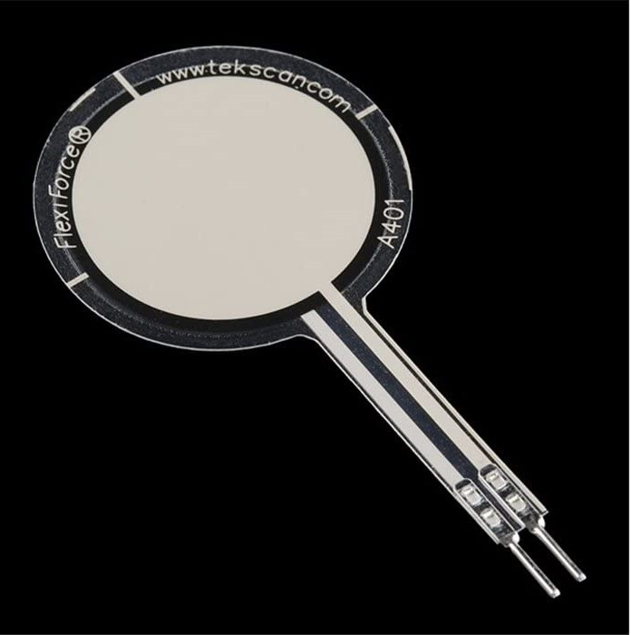
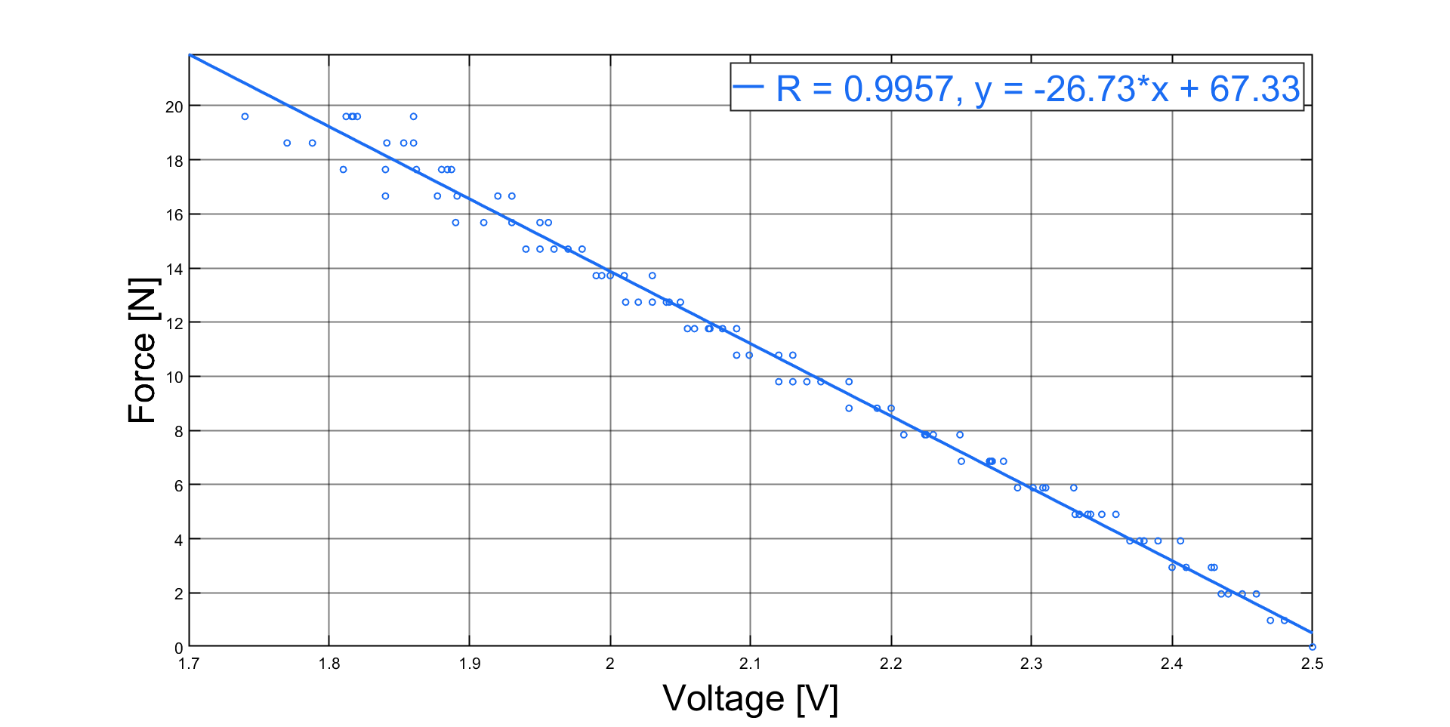
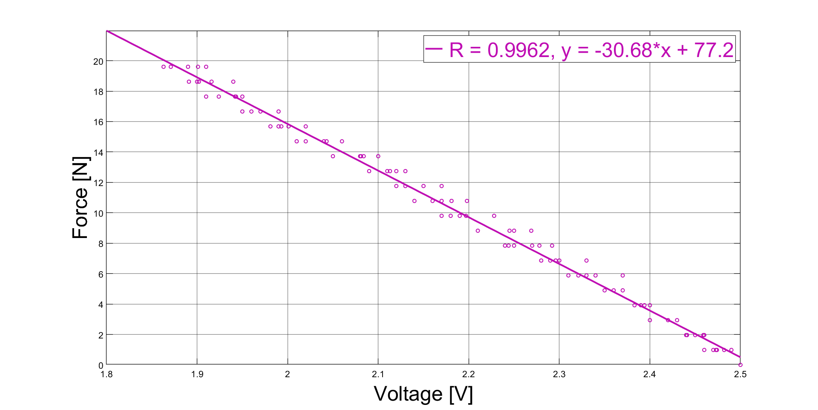
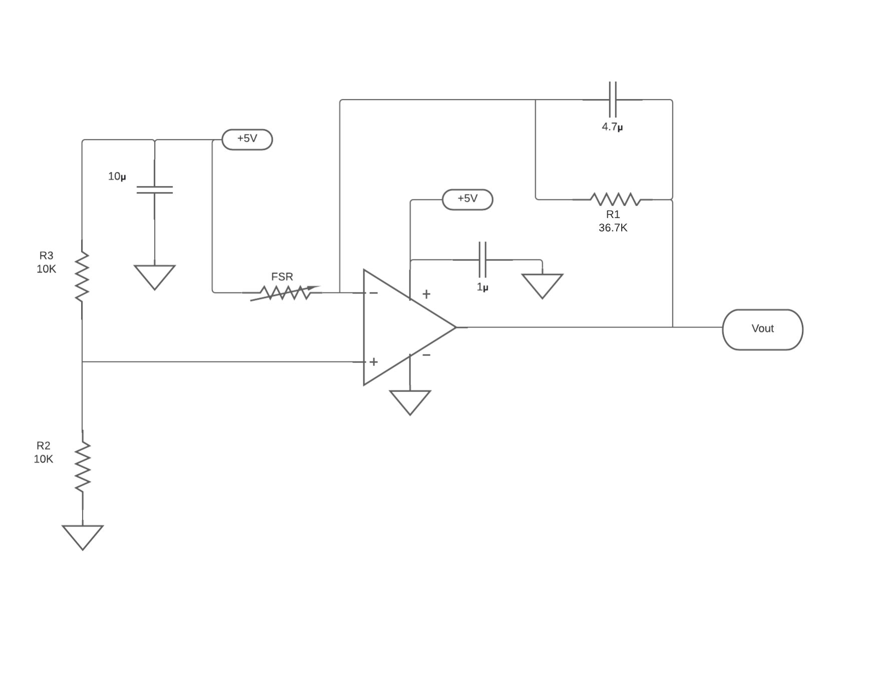
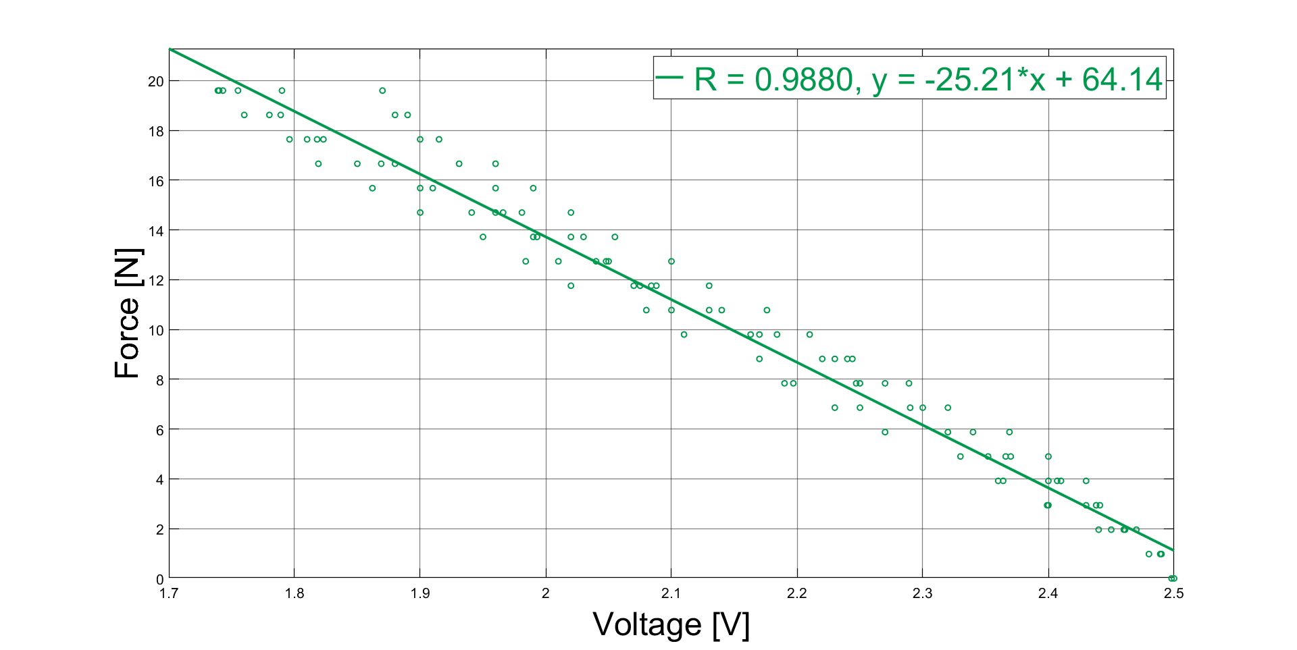
Hand Device System Overview - Sensor Integration
Force Sensing Resistor (FSR)
Thin and flexible characteristics allows integration of the FSR on the knob for grasping force measurement
Electrical resistance is inversely proportional to the applied force and is proportional to voltage
FSR calibration
Figure 4. FSR^{[8]}
Figure 5. FSR circuit
Figure 6. FSR calibration results
Notes:
Okay so that was the existing device. Now to acquire the grasping force we decide to use Force Sensing Resistors or FSR because of its thin and flexible characteristics and its inversely proportional relationship between electrical resistance and the applied force. We designed a circuit here in blue around the FSR to obtain a voltage and as force is applied on the FSR its resistance will decrease and the Voltage out will also decrease. We characterized the FSR by applying different weights and recording the voltage. And we plotted this for the 3 FSRs and obtained their linear equation. These 3 FSRs will be integrated on the knob and allow us to obtain the force applied by the thumb, index finger, and middle finger.

Slide 5
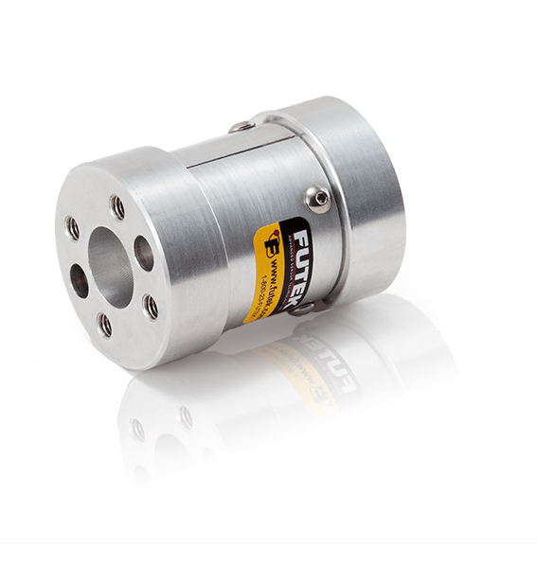
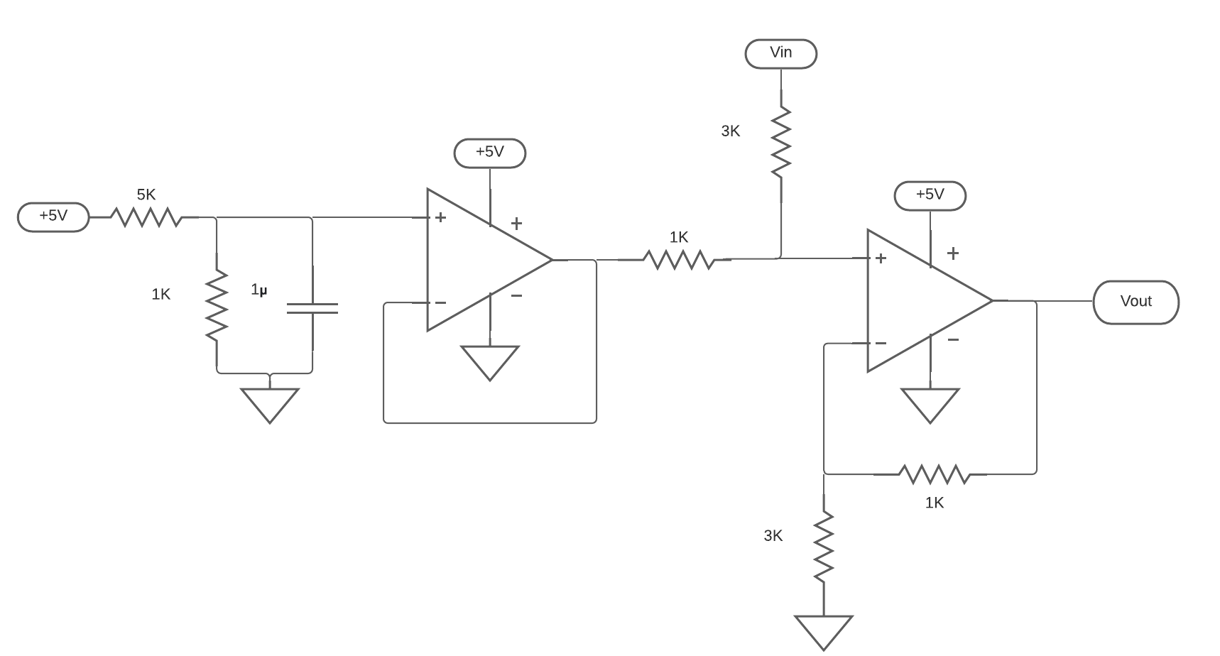
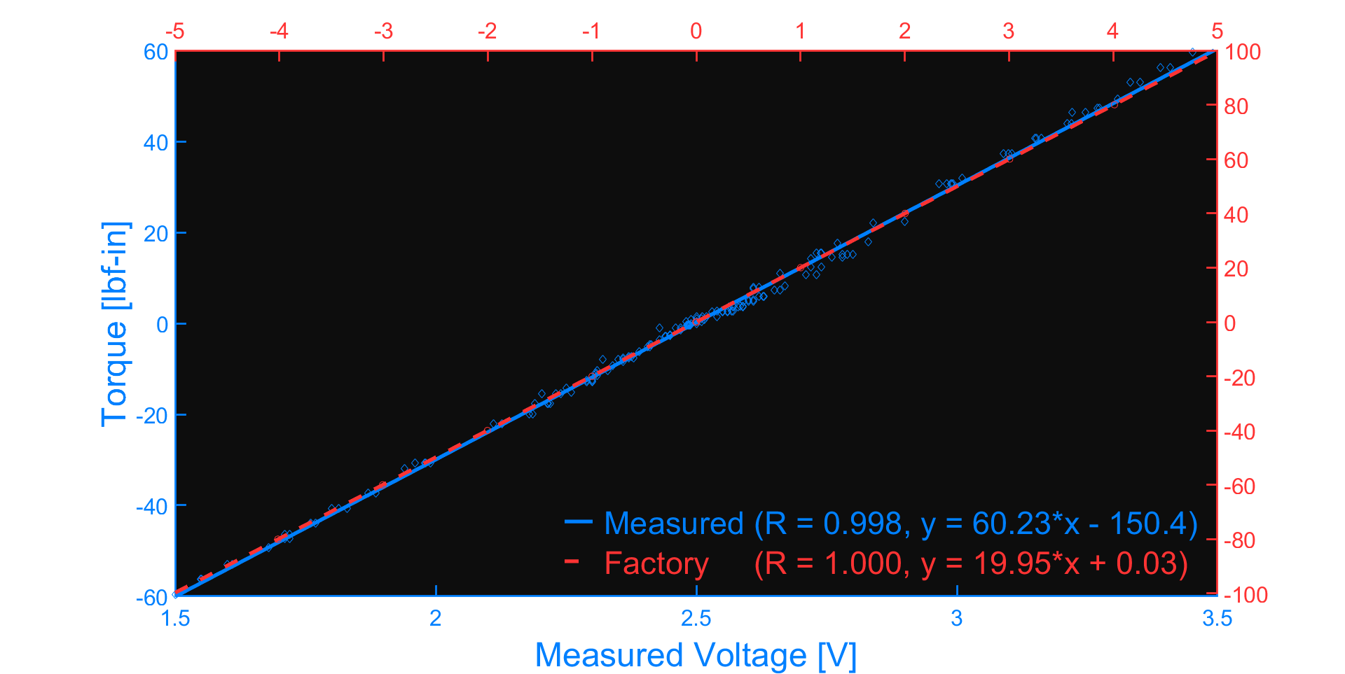
Hand Device System Overview - Sensor Integration
Torque Sensor
Converts an applied torque into an electrical voltage output signal
Torque sensor calibration
Figure 7. FUTEK torque sensor model TFF350
Figure 8. Shifter circuit
Figure 9. Calibration comparison
Notes:
We did a similar calibration procedure with our torque sensor where we applied different weights from a certain distance from the axis of rotation and recorded the voltage at various torque values. We used the shifter circuit here in the green in order to shift the output voltage into a range of 0-5V voltage values that can be inputted to the Arduino microcontroller. The figure on the right demonstrates the linear equation we obtained with the shifter circuit with the calibration process and we verified the torque reading with the reference values given by the manufacturer.

Slide 6
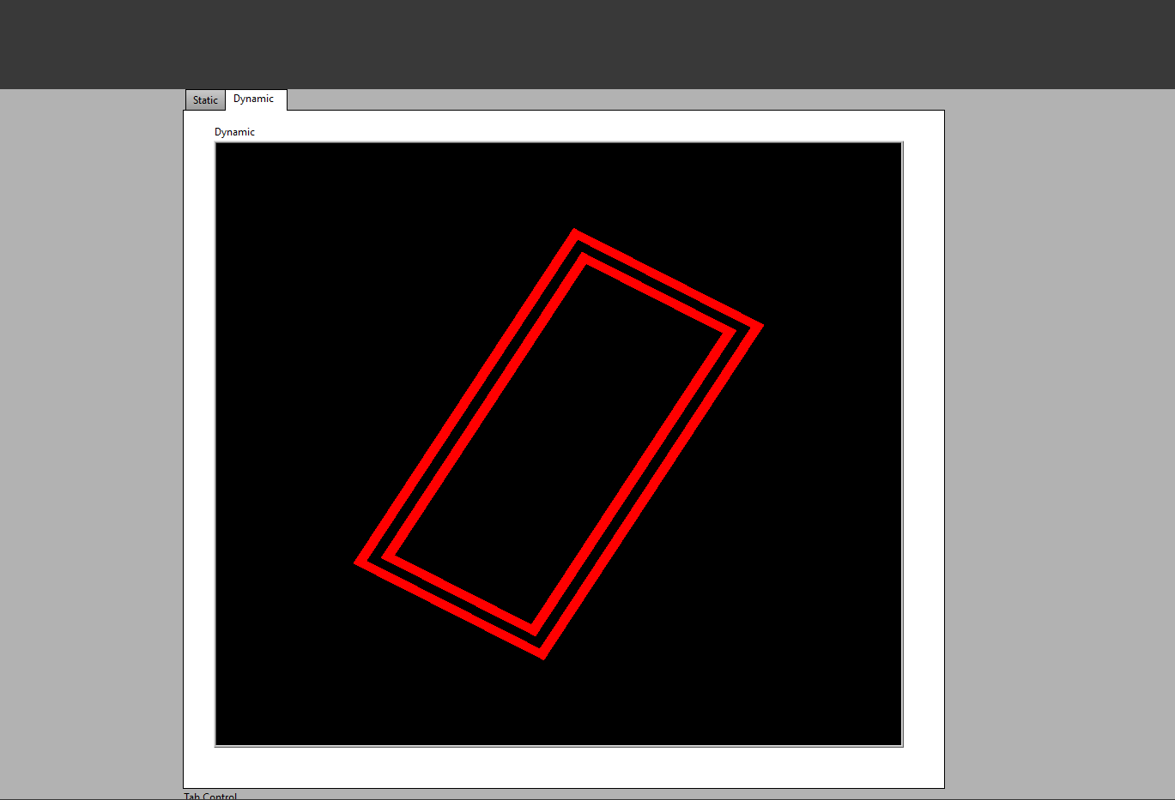
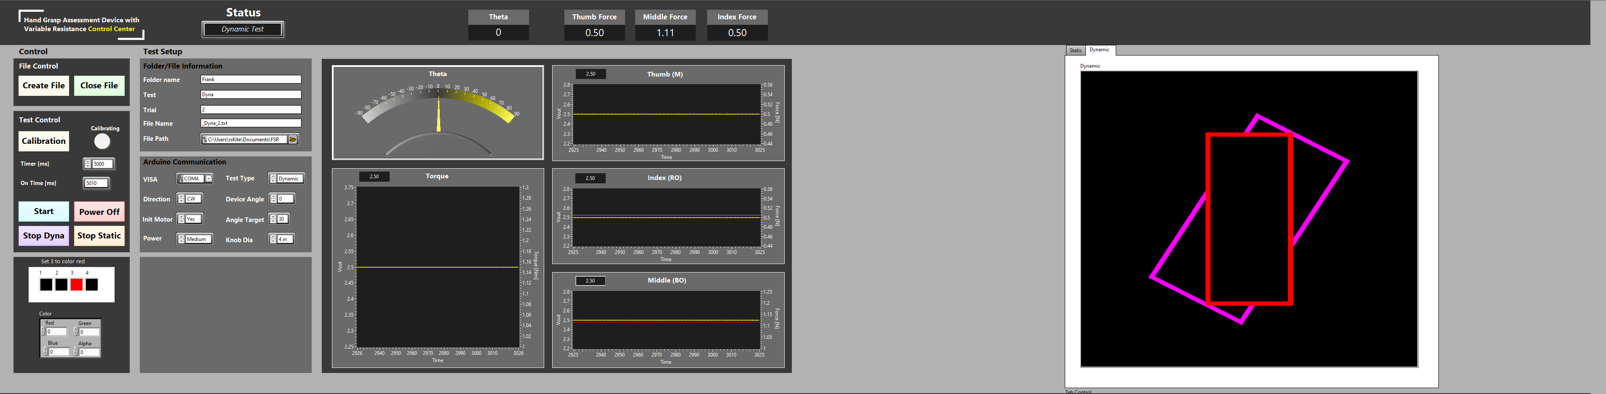
Hand Device System Overview –Graphical User Interface (GUI)
Developed in LabVIEW to display experiment variables
Redesigned to provide visual feedback to the user and data collection
Figure 11. Visual feedback: user reaches the target
Figure 10. Full GUI View shown in a dynamic test
Notes:
Apart from the physical device, we are using a Graphical User Interface developed in LabVIEW to display and collect experiment variables. Here we have the redesigned the GUI be displayed in two windows, one for the operator to control the experiment parameters and to record data and one for the user for visual feedback. For example, here during a dynamic test, the user will be asked to turn the knob to the target and once the target is met the outer rectangle will turn red.

Slide 7
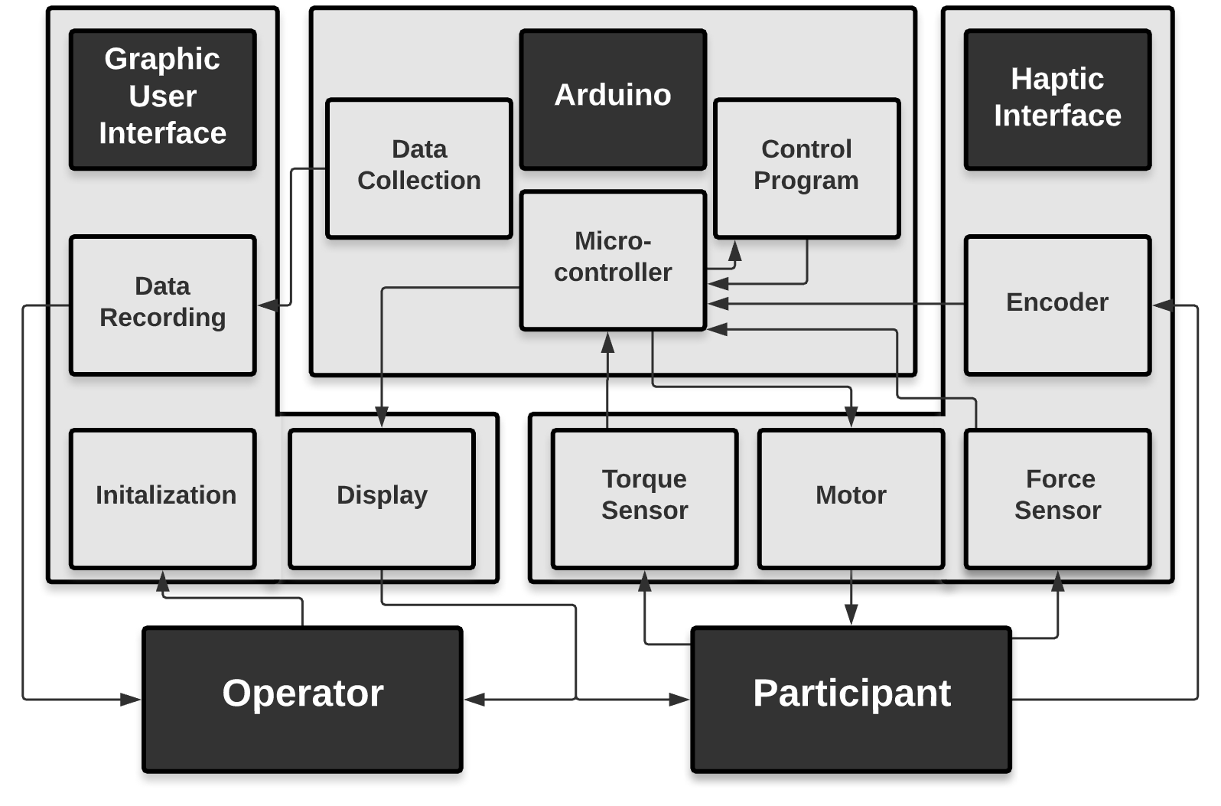
Hand Device System Overview
Figure 12. System design layout
Notes:
To summarize, our system is centered around Arduino and we have both a Graphical User Interface and a Haptic Interface. Haptic interface provides haptic feedback and is comprised of the sensors and DC motor. And so, the Arduino controls and allows us to apply that variable resistance and reads the torque and grasping force the user is applying. Arduino also send this information to the GUI and the GUI allows the operator to initialize and record data while the user will receive visual feedback.

Slide 8
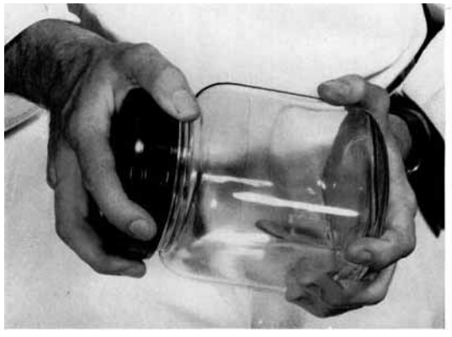
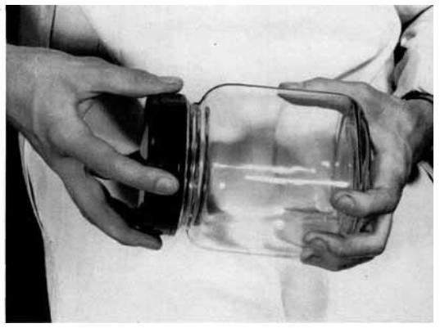
Human Subject Experiment Protocol
Static Test (Power Focus)
Max turning torque at varying knob sizes and wrist extension
Dynamic Test (Precision Focus)
Grasping force against turning torque at different resistance levels
Target over- and undershoot of turn angle at varying torque feedback
Time to target during target angle test
Figure 13. Transition of a power grasp (top) into a precision grasp (bottom) while opening a jar^{[9]}
Notes:
To assess hand function during a task, we must remember that our interactions with the environment require both power and precision. For example, while open a jar we transition from a power grasp into a precision grasp. Therefore, during our baseline data collection in the future, we will conduct both a static and dynamic test and gather data for both hands and in both pronation and supination. In the static test we will evaluate maximum torque by asking the participant to apply the maximum torque they can at varying knob sizes and wrist extension. The dynamic test will focus on hand torque control by analyzing grasping force against turning torque at different resistance levels, target over and undershoot of turn angle, and the time to the target.

Slide 9
Future Work
Redesign knobs for FSR integration and design attachment for static testing
Test the functionality of the device with healthy subjects
Baseline data collection for assessing coordination between grasping force and turning torque with healthy and hand impaired subjects
Integration of a grip force/load force device that was previously developed for a more detailed hand evaluation
Notes:
Finally, to complete the device we will redesign the 3 knobs for FSR integration and an attachment for static testing. In the future, we will first test the device with healthy subjects and then collect baseline data for assessment between healthy and hand impaired groups. And finally, we plan on integrating a previous device that measures grip force against load force for a complete hand evaluation.

Slide 10
References & Acknowledgements
Carmeli, E., et al. “The Aging Hand.” The Journals of Gerontology: Series A, vol. 58, no. 2, 1 Feb. 2003, doi:10.1093/gerona/58.2.m146.
Gurari, N., and A. M. Okamura. “Human Performance in a Knob-Turning Task.” Second Joint EuroHaptics Conference and Symposium on Haptic Interfaces for Virtual Environment and Teleoperator Systems (WHC'07), 2007, doi:10.1109/whc.2007.71
Herrera, D. "Hand Force and Arm Movement Coordination in Static and Dynamic Manipulation Tasks." California State University, Long Beach, 2018. [MS Thesis]
Kazemi, H., et al. “A Robotic Interface to Train Grip Strength, Grip Coordination and Finger Extension Following Stroke.” 2012 Annual International Conference of the IEEE Engineering in Medicine and Biology Society, 28 Aug. 2012, doi:10.1109/embc.2012.6346820.
Metzger, J., et al. “Design and Characterization of the ReHapticKnob, a Robot for Assessment and Therapy of Hand Function.” 2011 IEEE/RSJ International Conference on Intelligent Robots and Systems, 25 Sept. 2011, doi:10.1109/iros.2011.6094882.
Romeo, R.A, et al. "Development and preliminary testing of an instrumented object for force analysis during grasping," 2015 37th Annual Conference of the IEEE Engineering in Medicine and Biology Society (EMBC), Milan, 2015, doi: 10.1109/EMBC.2015.7319935.
12 x Candle or Storage Jar. (n.d.). [Photograph]. Pastimes. https://www.google.com/url?sa=i&url=https%3A%2F%2Fwww.pastimesltd.co.uk%2F12-x-candle-or-storage-jar-2698-p.asp&psig=AOvVaw3DwXC7F2fkro_Gv1-1bnD1&ust=1615059864829000&source=images&cd=vfe&ved=0CAIQjRxqFwoTCODT4_30me8CFQAAAAAdAAAAABBW
FLEXIFORCE A401 SENSOR 25LBS. (n.d.). [Photograph]. Antratek Electronics. https://cdn.antratek.nl/media/product/8c2/flexiforce-a401-sensor-25lbs-sen-11207-098.jpg
Napier, John R. "The prehensile movements of the human hand." The Journal of bone and joint surgery. British volume 38, no. 4 (1956): 902-913, doi: 10.1302/0301-620X.38B4.902.
This research was supported by the National Institute of General Medical Sciences of the National Institutes of Health under Award Numbers; UL1GM118979; TL4GM118980; RL5GM118978. The content is solely the responsibility of the authors and does not necessarily represent the official views of the National Institutes of Health. The authors would like to thank Don G. Napasindayao for initial development of the device.
Notes:
Thanks for your time. I will like thank my mentors and acknowledge NIH and CSULB BUILD for funding our research.

